Slide 1

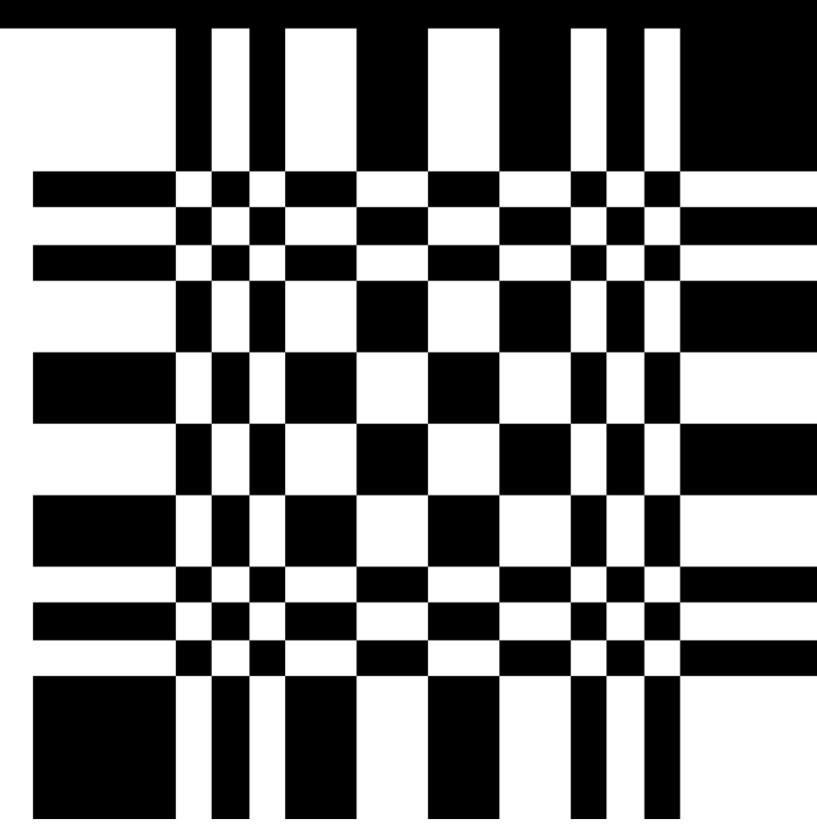


Xray pinhole camera (wip)
X-RAY SOURCE
DECODING PROCEDURE
RECONSTRUCTED IMAGE
X-RAYS
PATIENT
APERTURE
DETECTOR

Slide 2

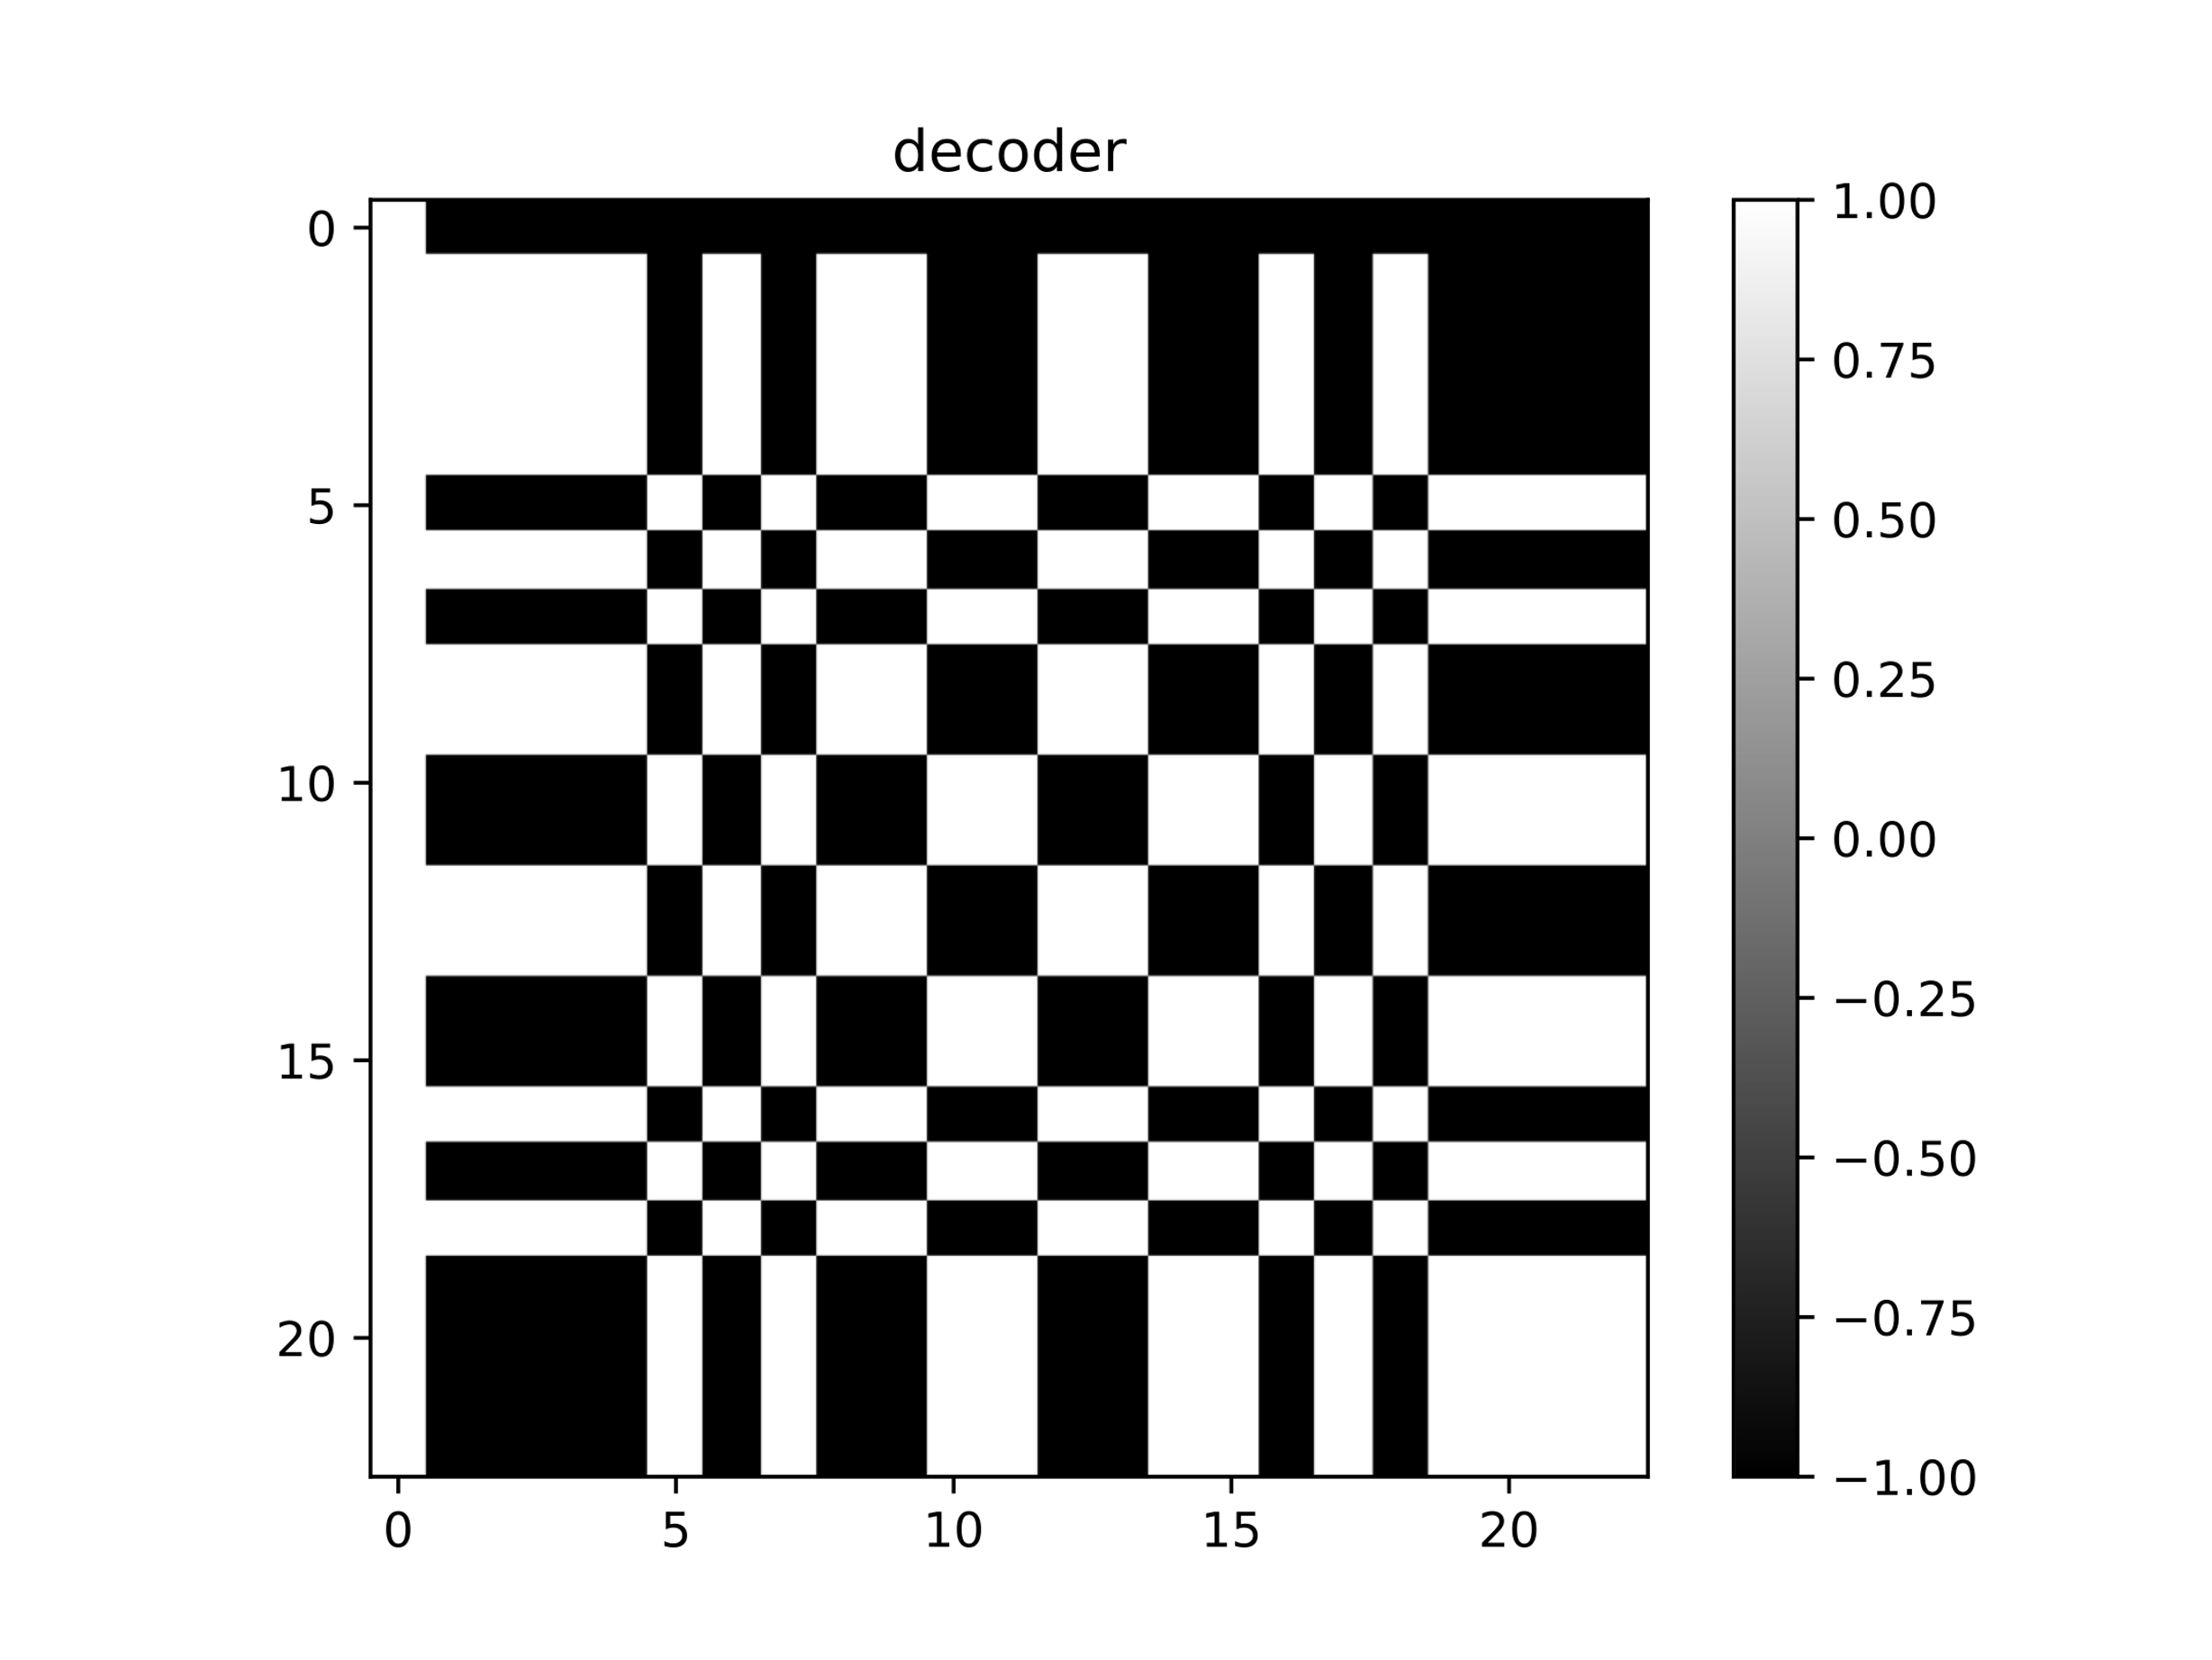
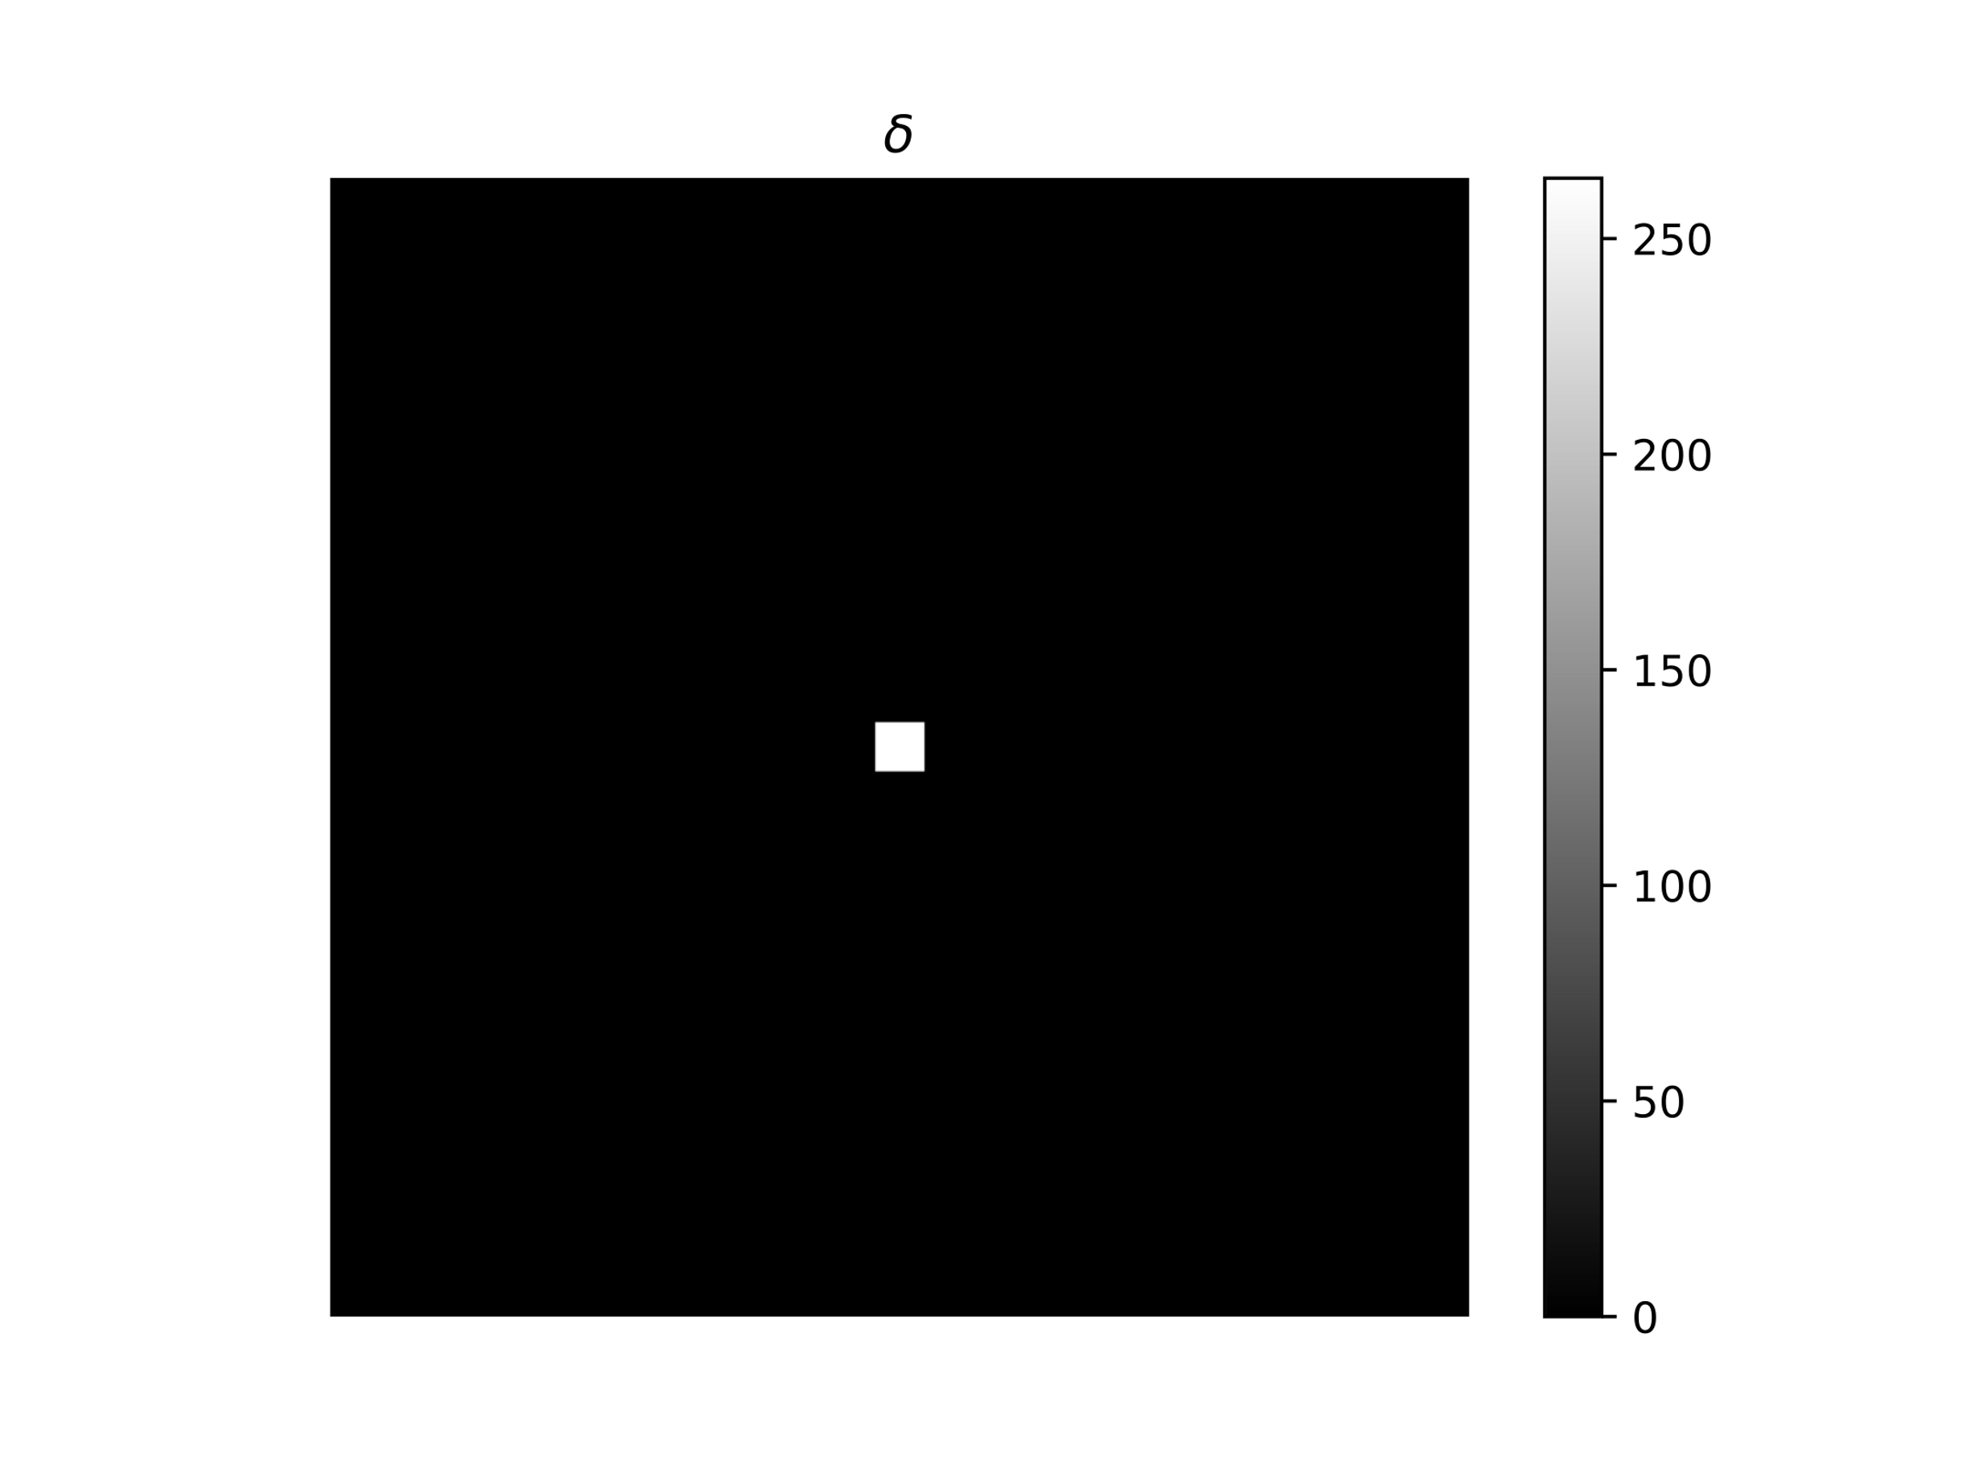
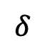
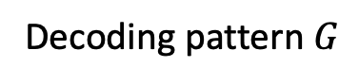

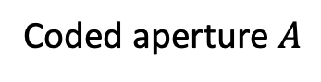

$$∗$$
$$=$$
Coded aperture $A$
Decoding pattern $G$
$$δ$$

Slide 3
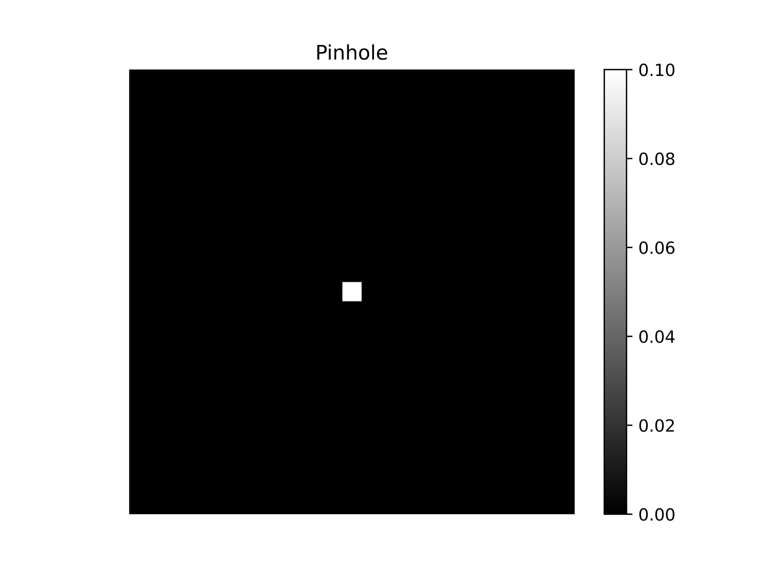
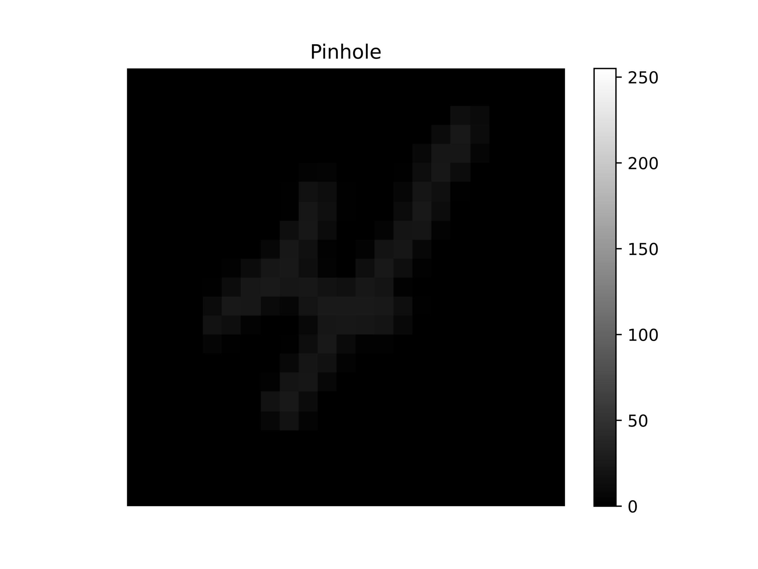
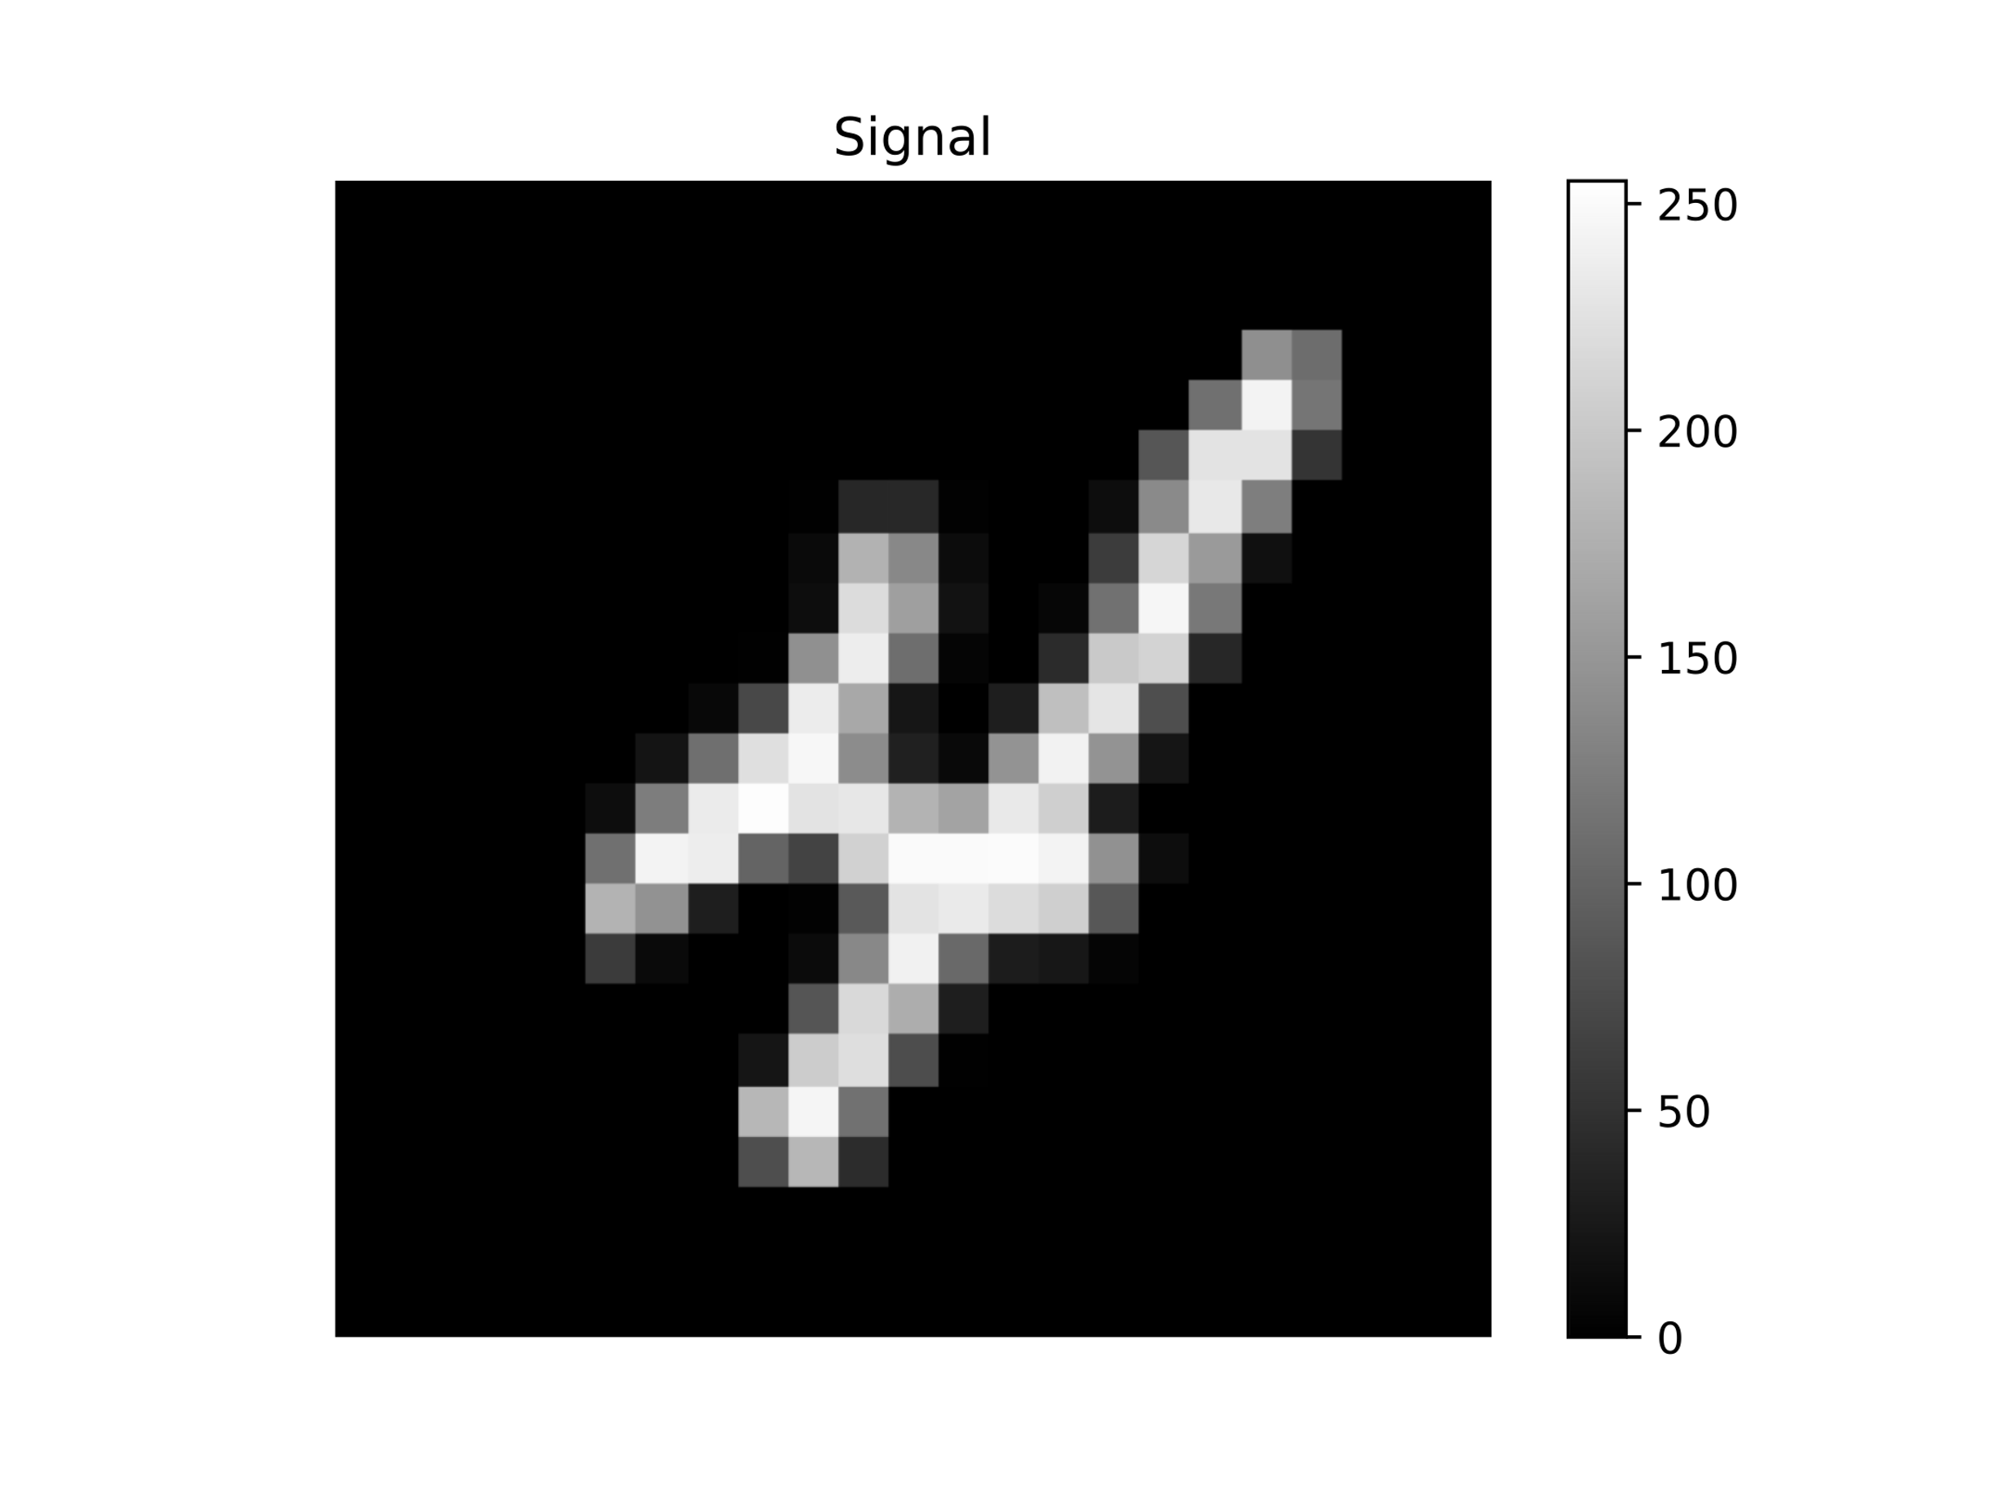
Aperture
Observation
Signal

Slide 4
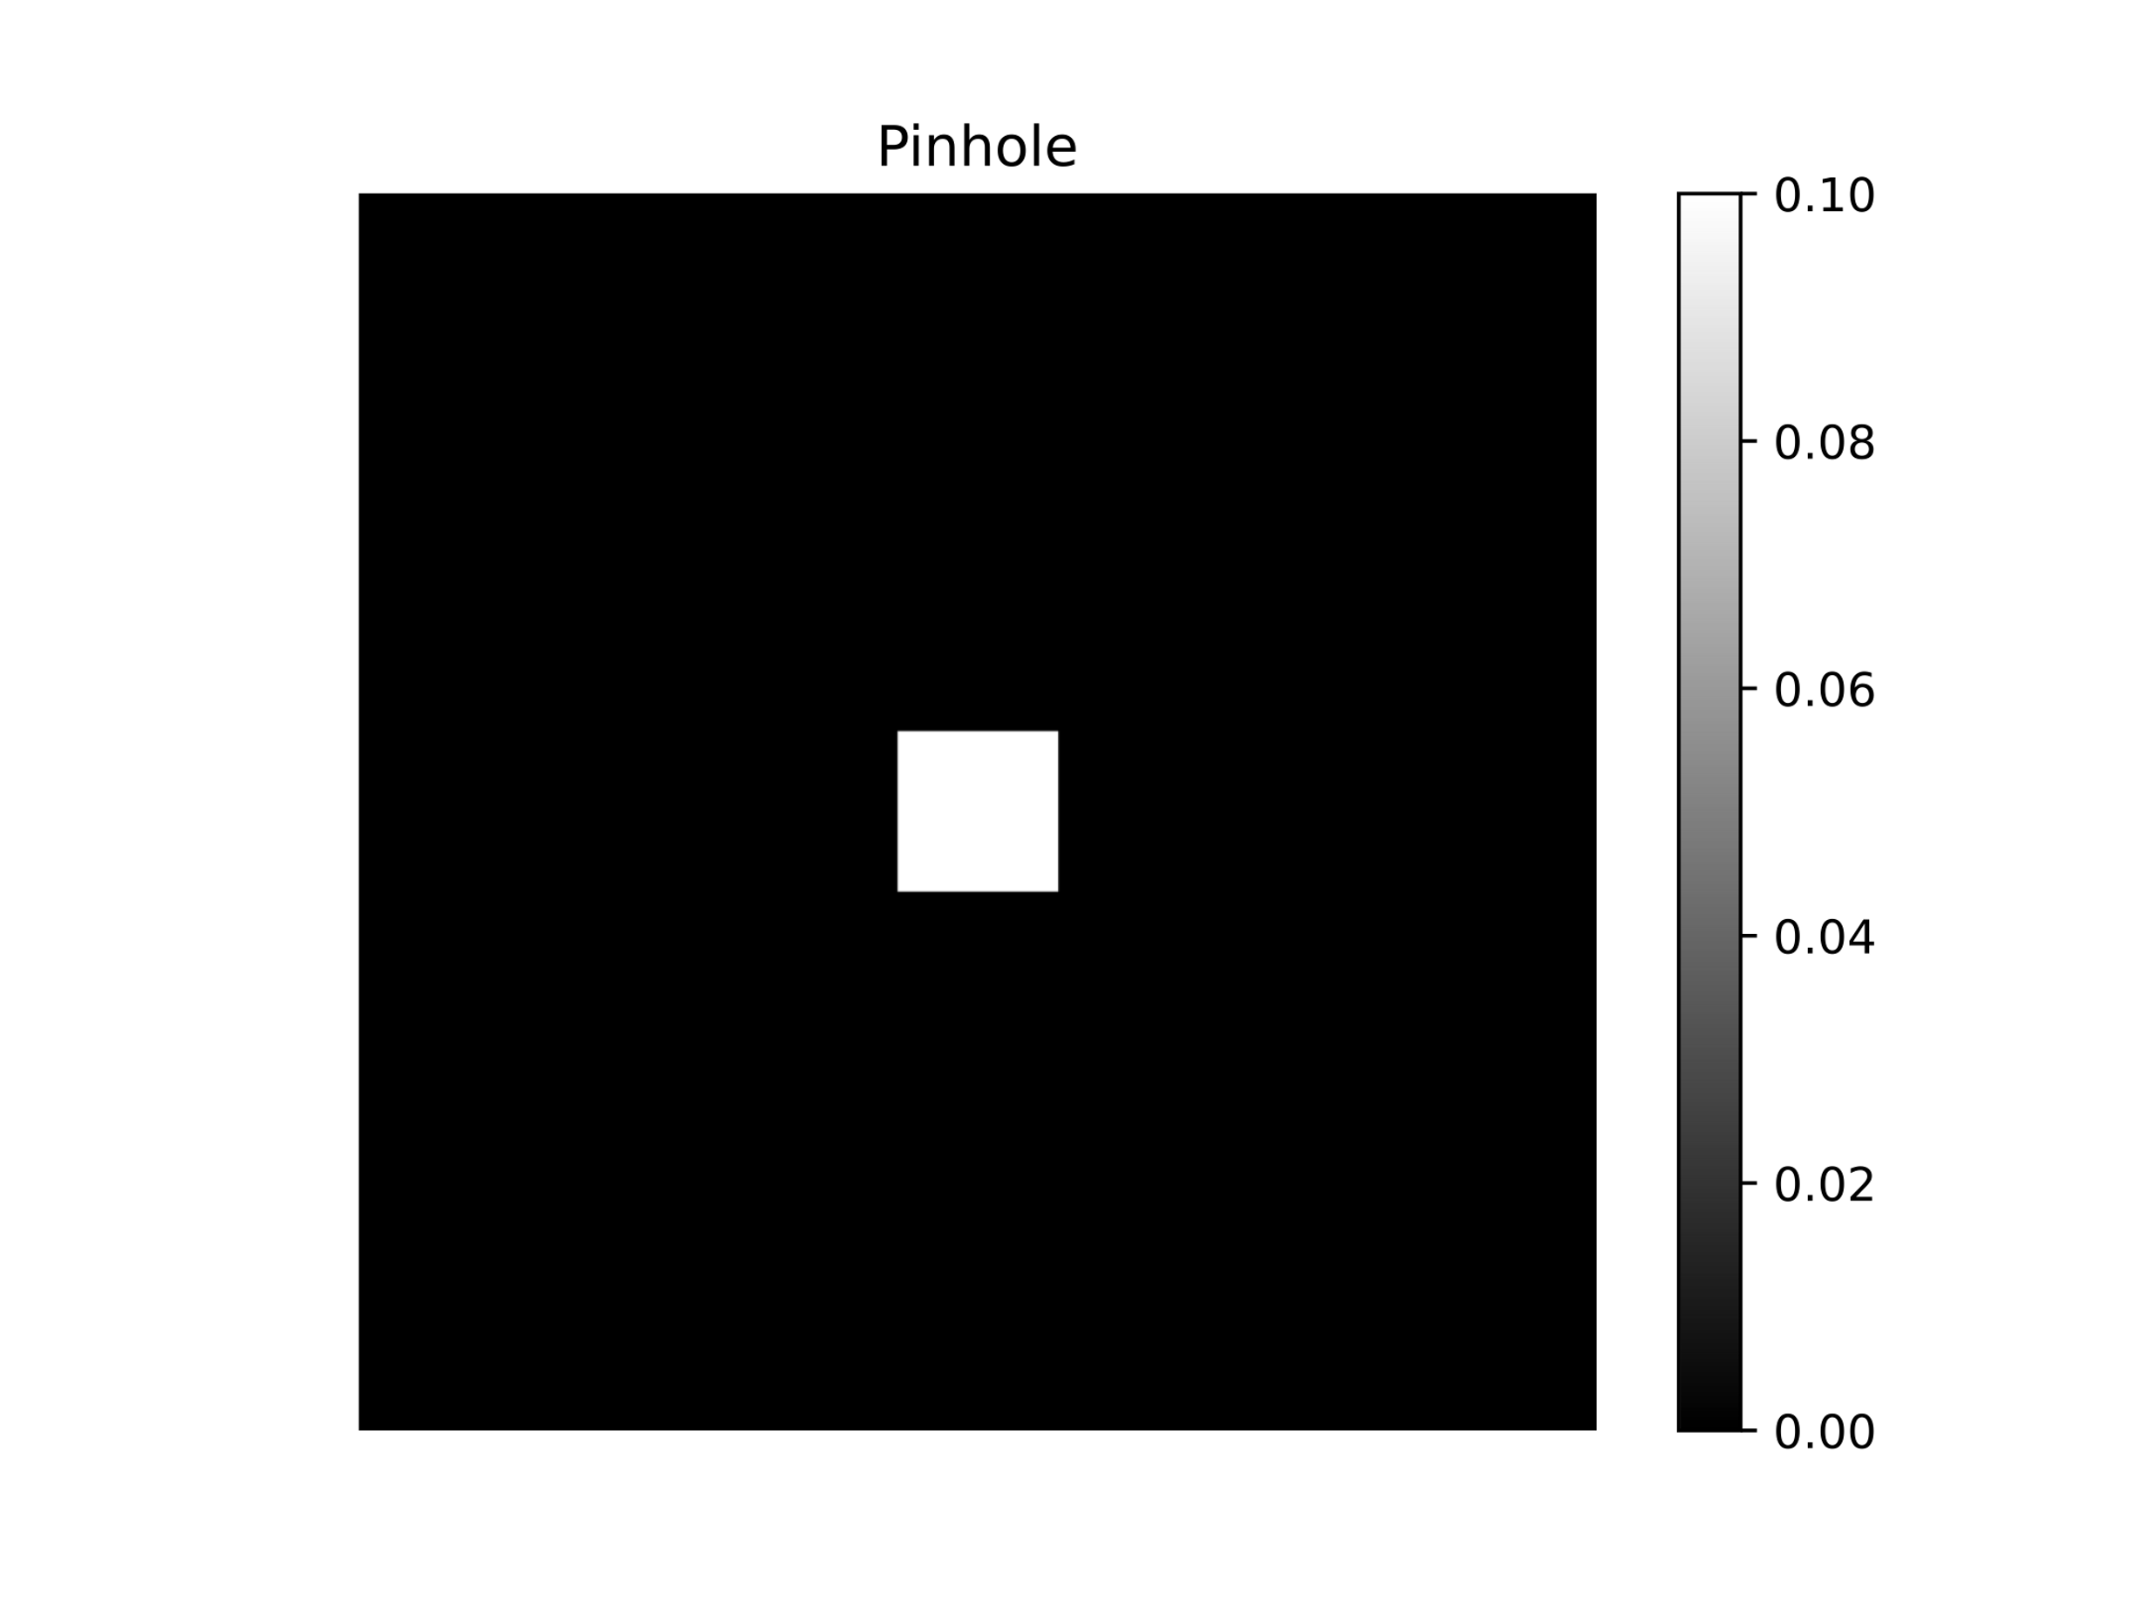
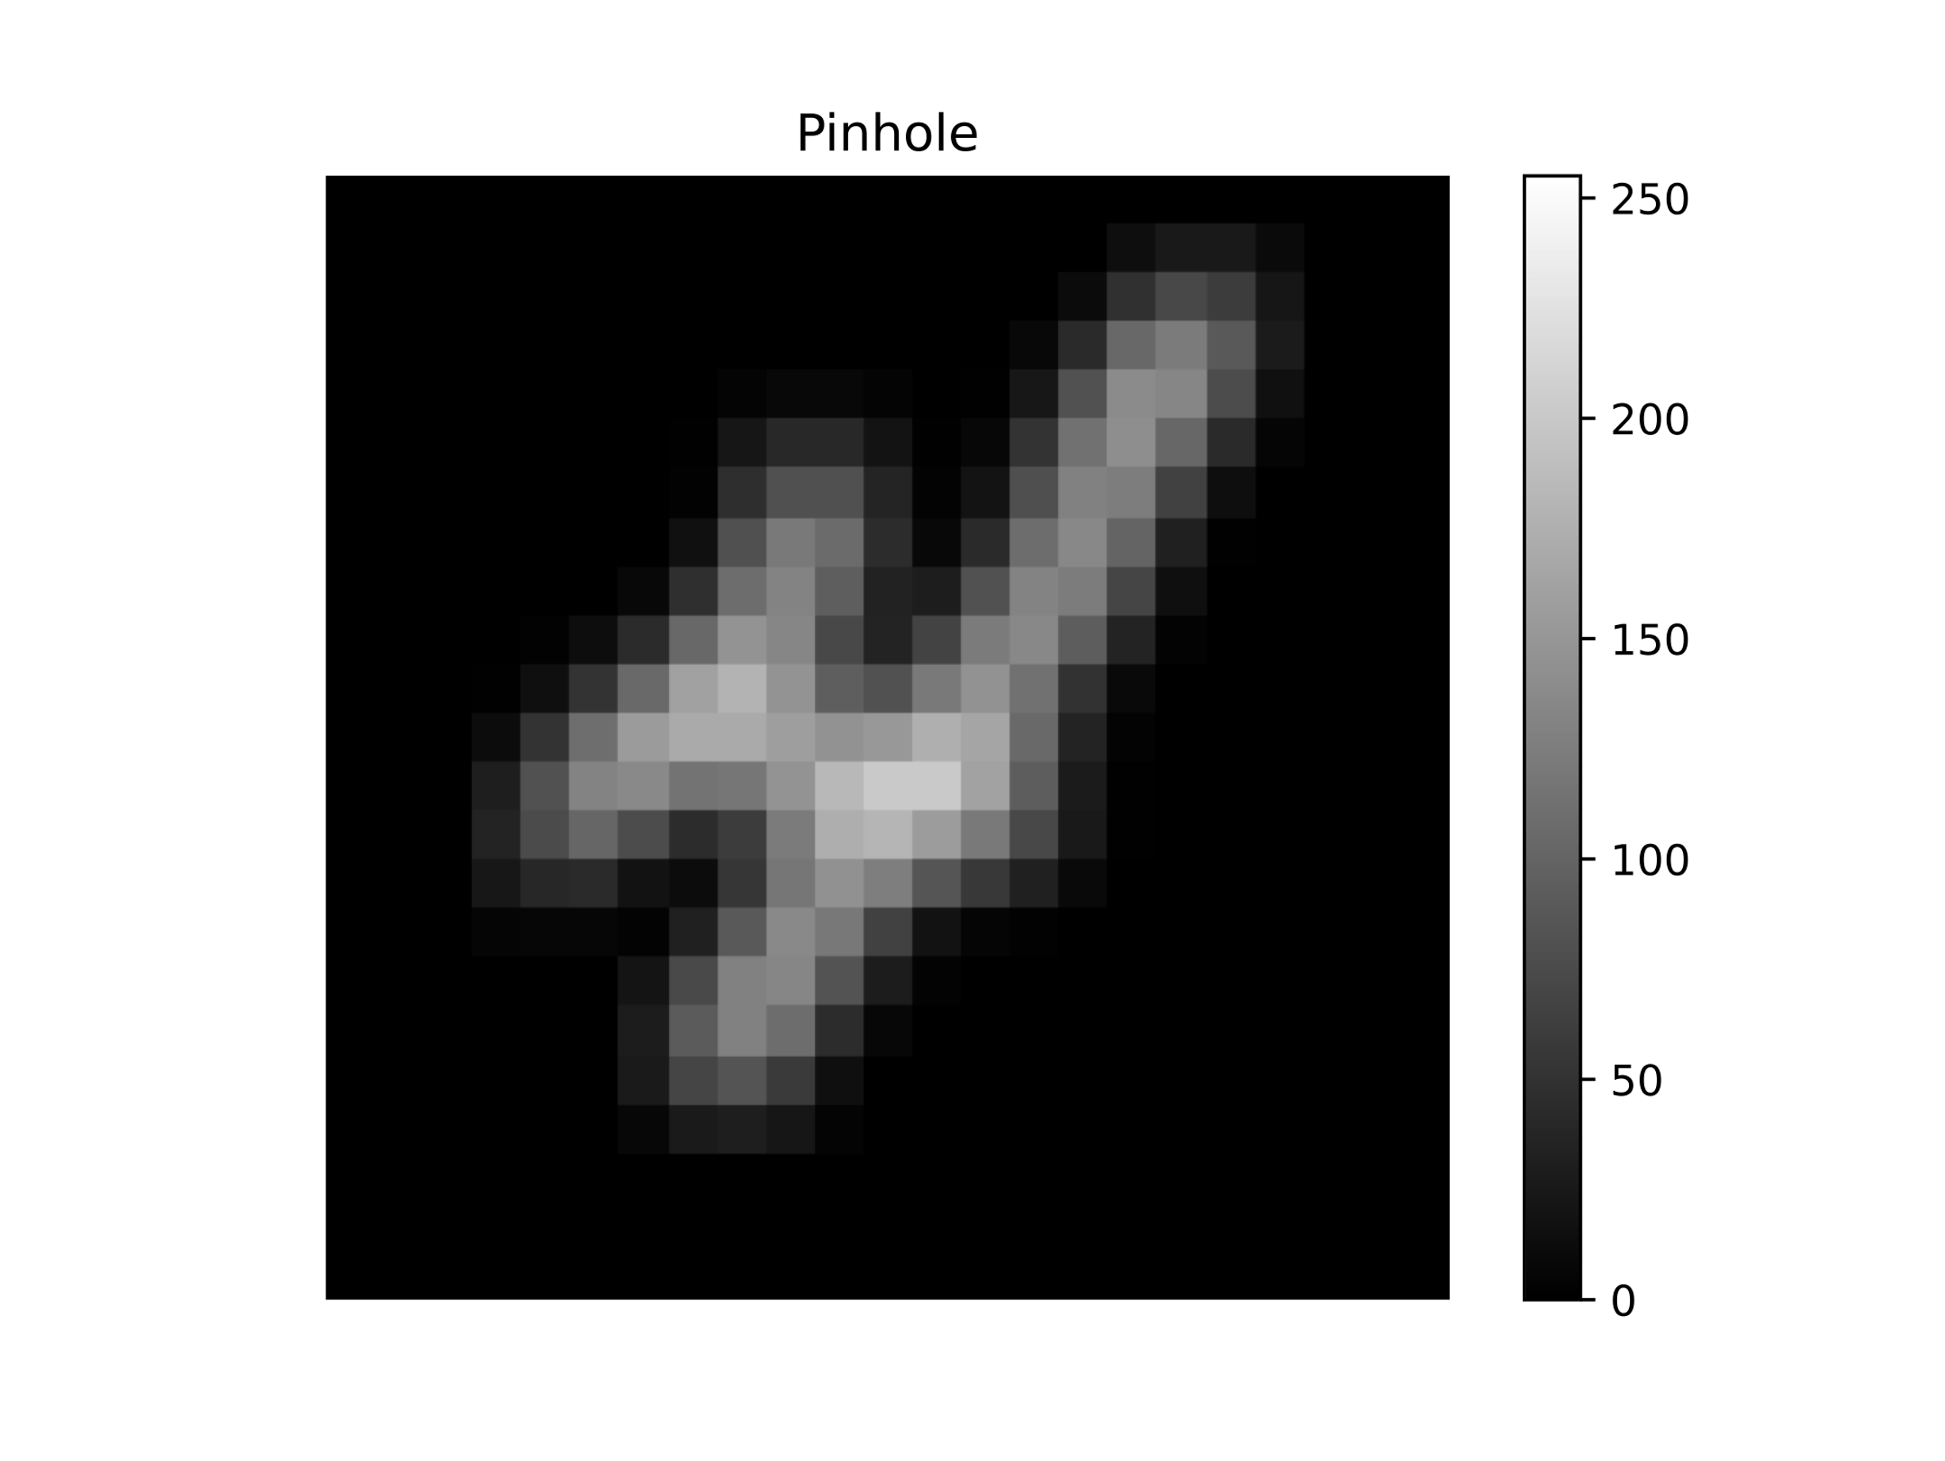
Aperture
Observation
Signal

Slide 5

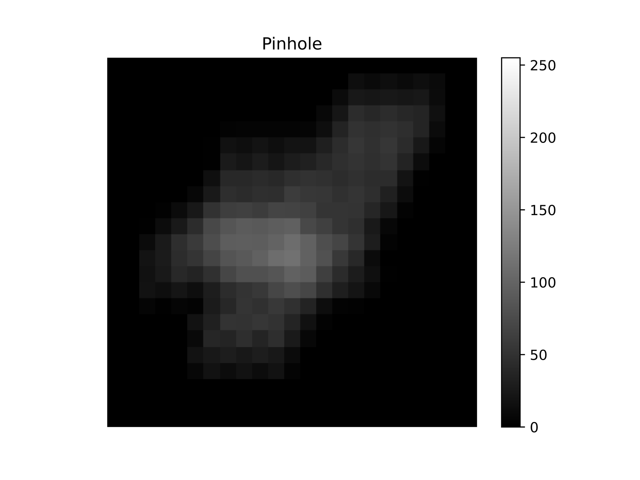
Aperture
Observation
Signal

Slide 6
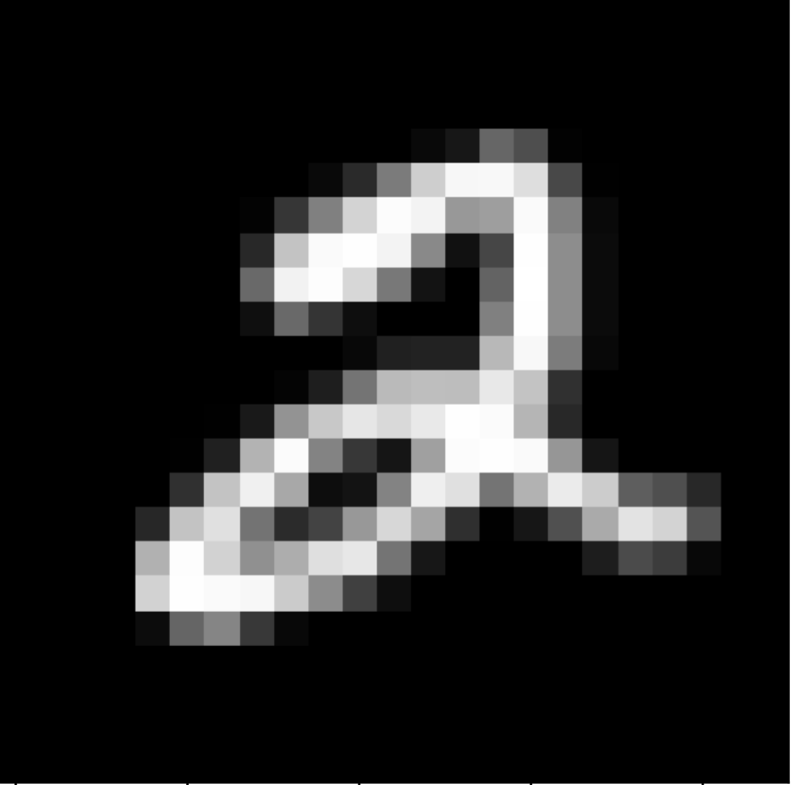



$$∗$$
$$∗$$
$$=$$

Slide 7
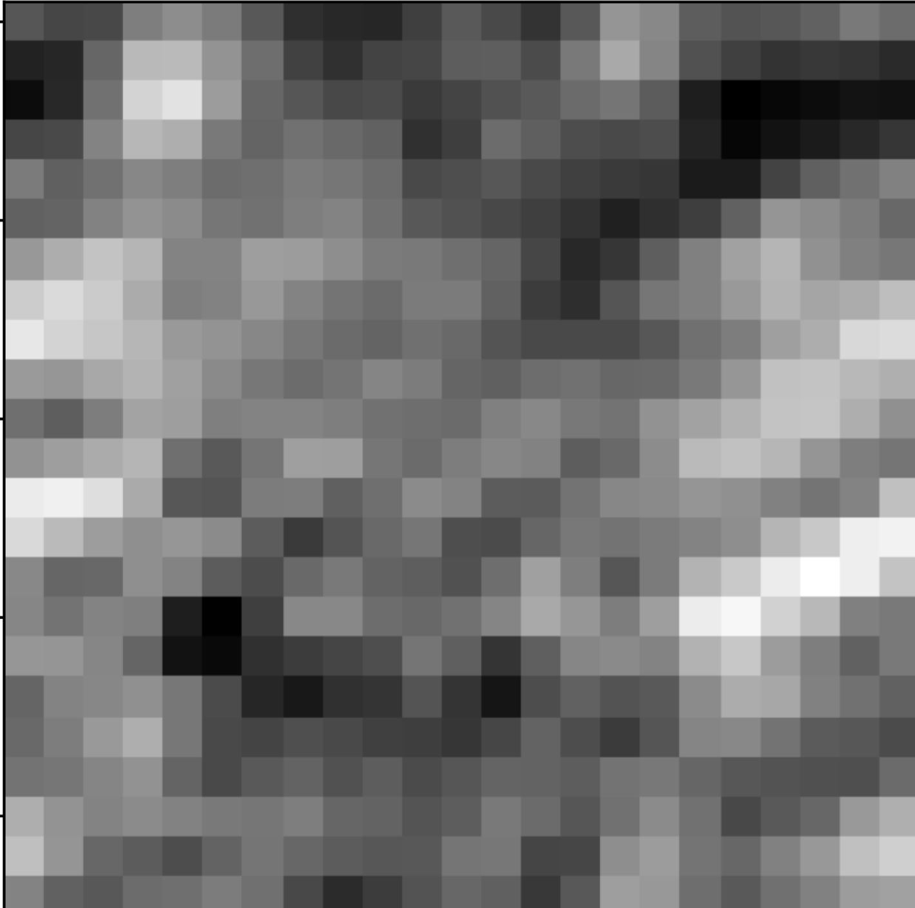
$$∗$$
$$∗$$
$$=$$
Coded observation

Slide 8




Signal
Aperture
Observation
Reconstruction
$$S$$
$$A$$
$$D$$
$$\hat{S}$$

Slide 9
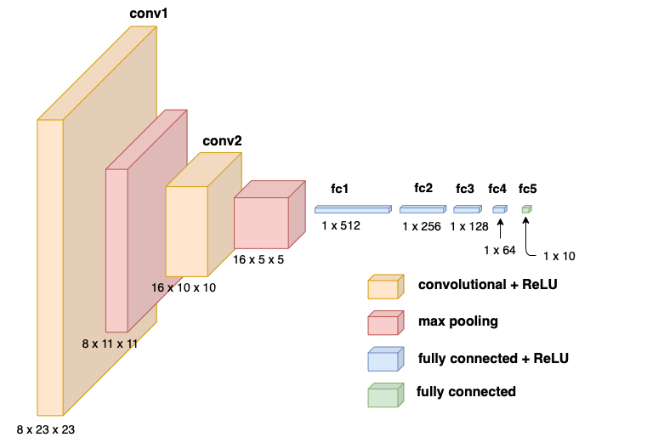
2
X-RAY SOURCE
X-RAYS
SOURCE
APERTURE
OBSERVATION
DECODING PROCEDURE
CLASSIFICATION

Slide 10
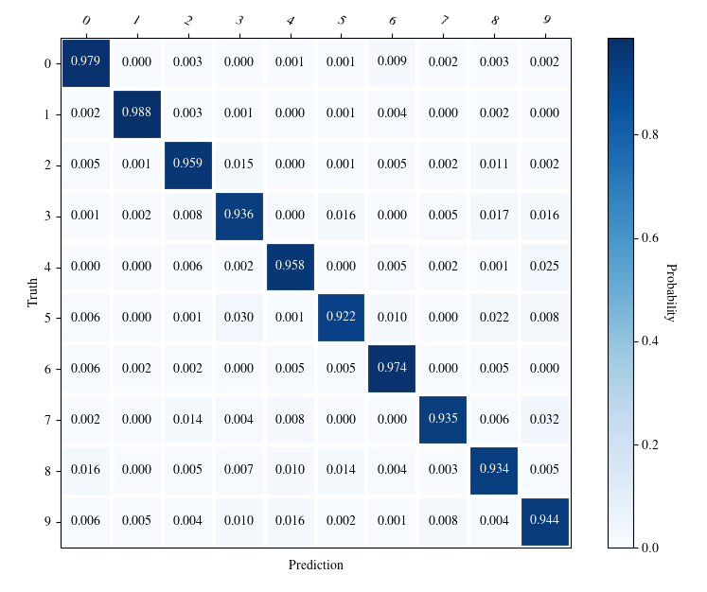

Slide 11
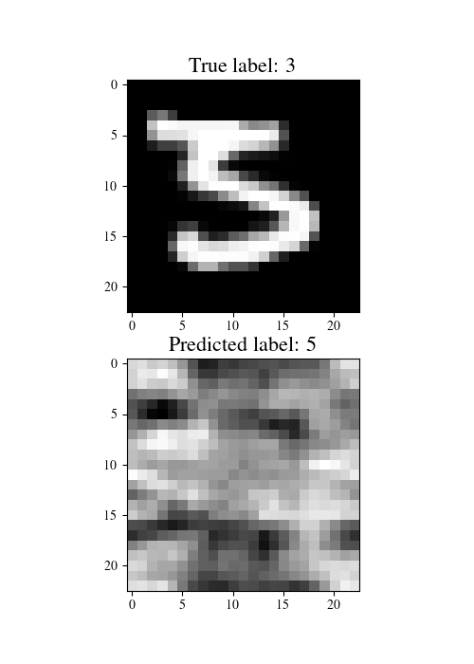
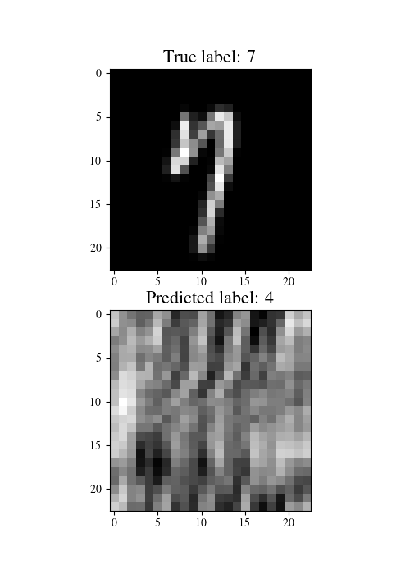
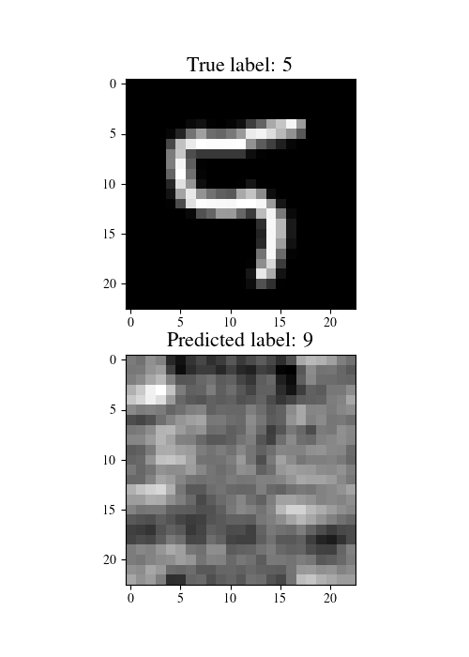
True image
Observation

Slide 13
Reconstruction Task

Slide 14
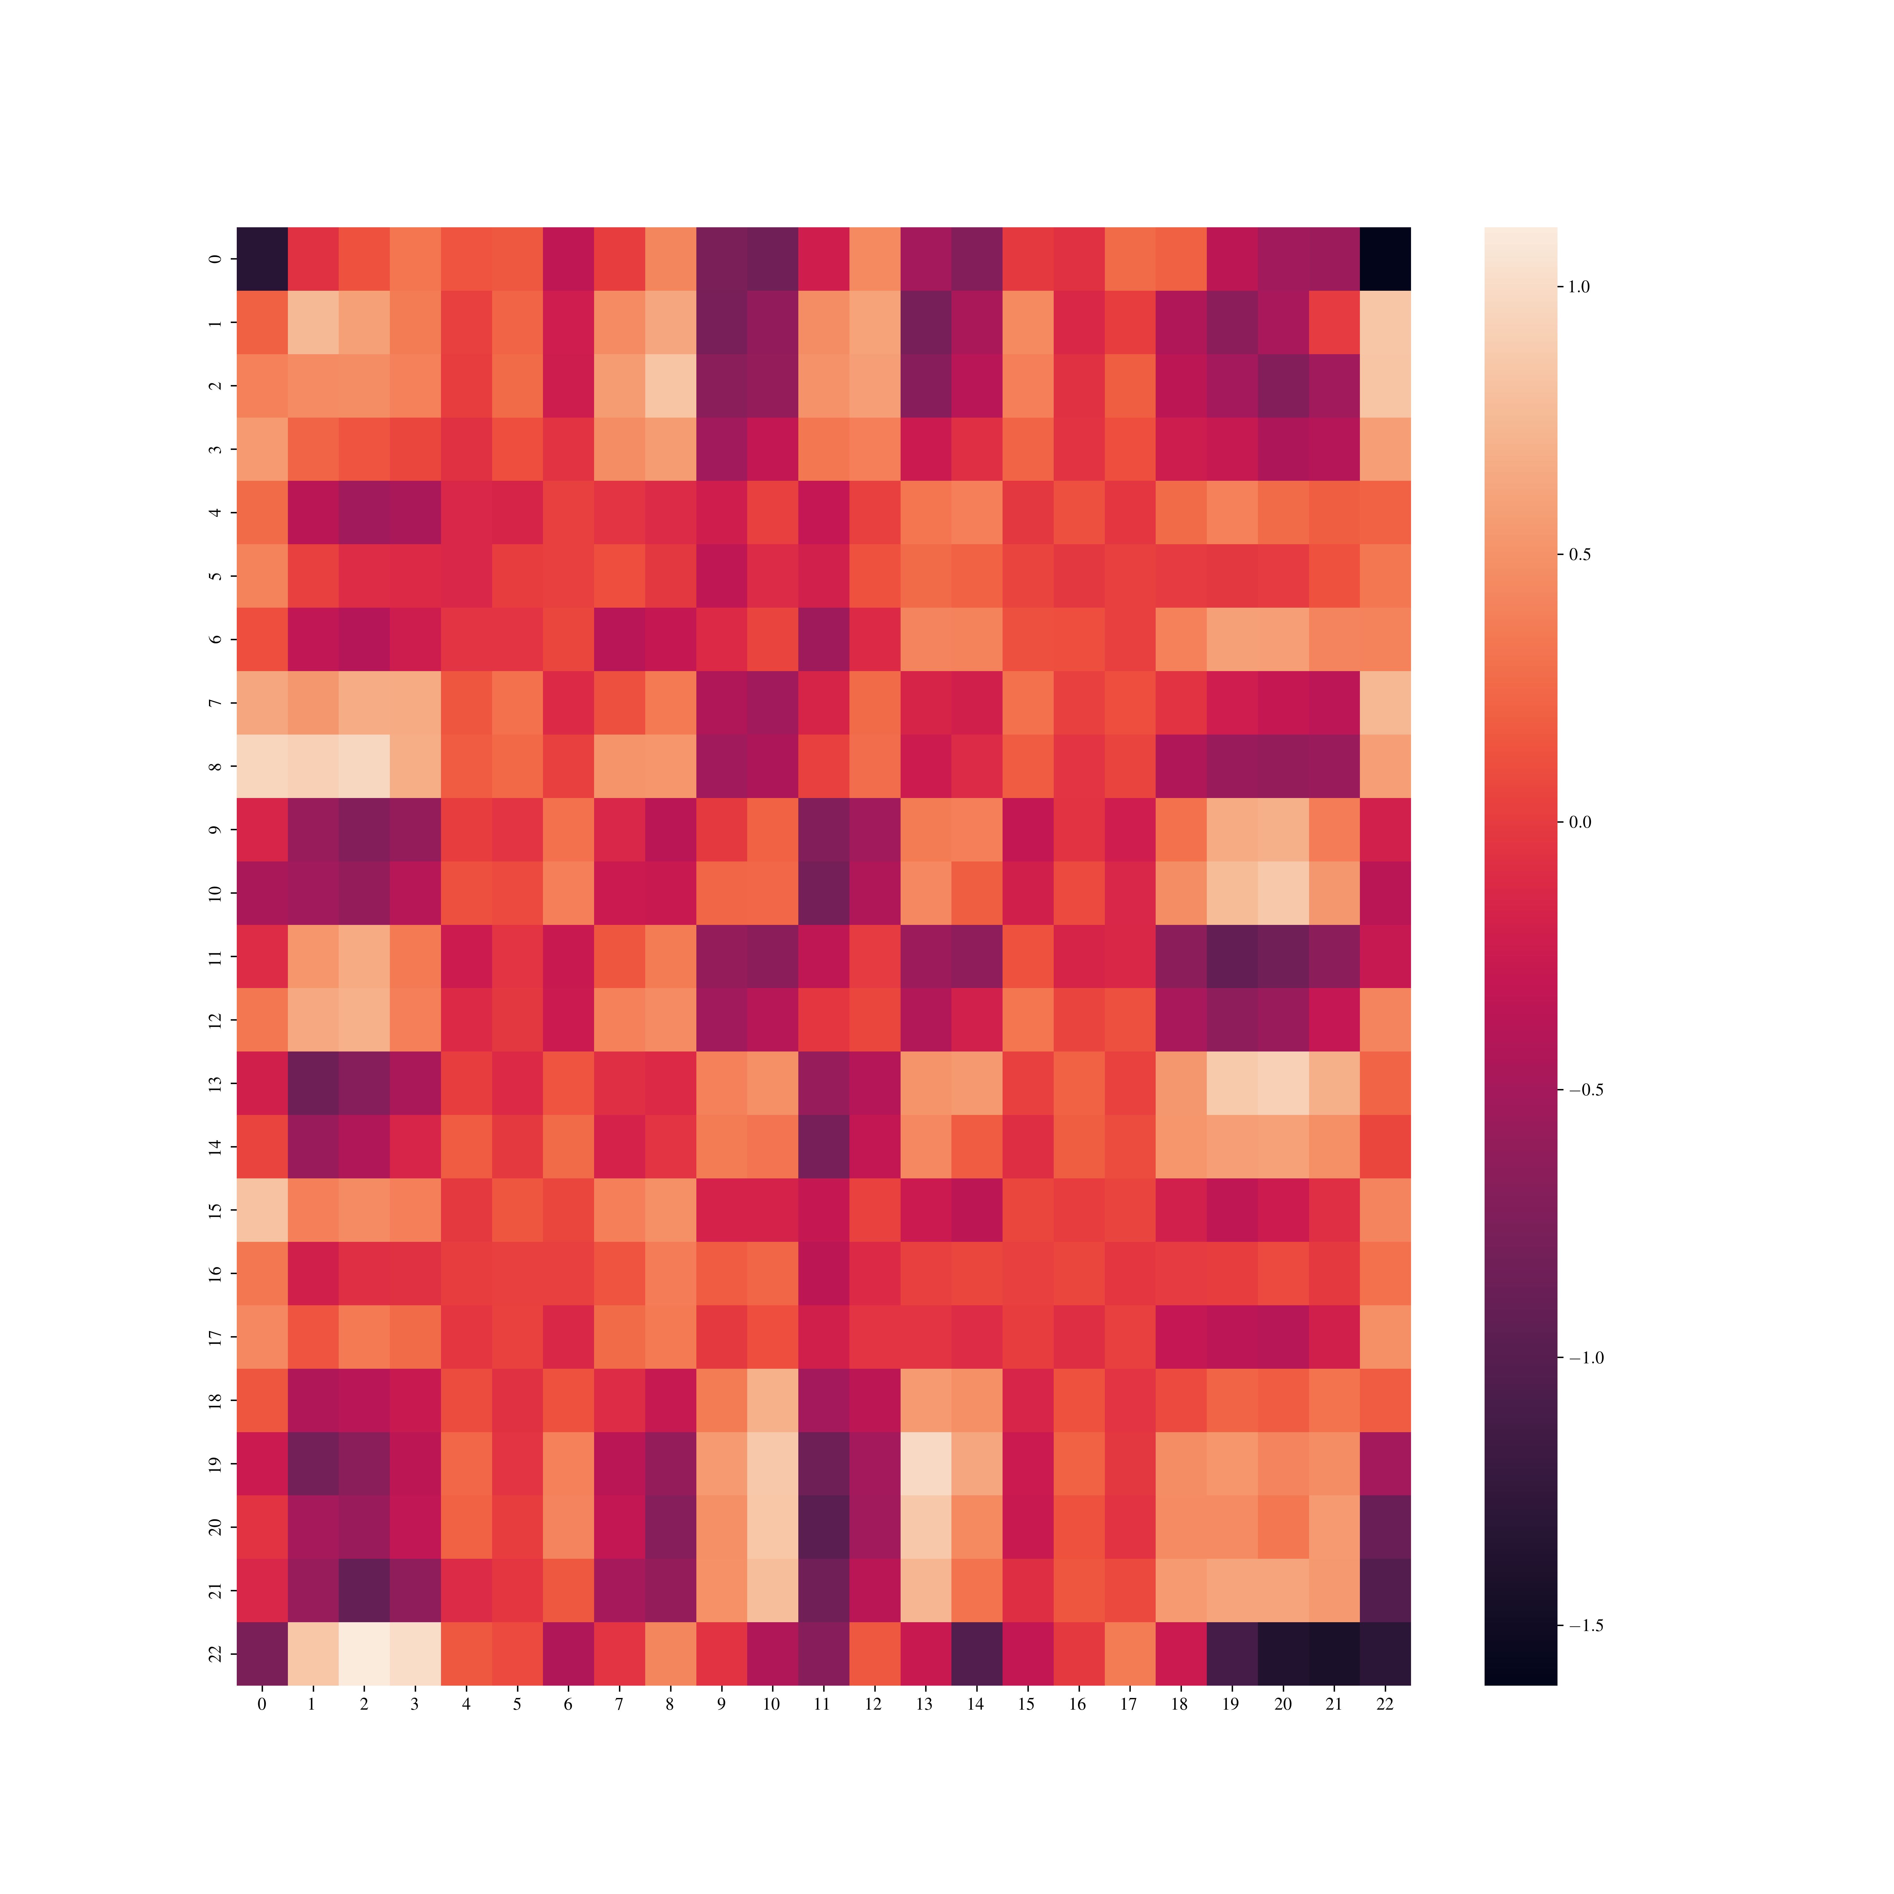
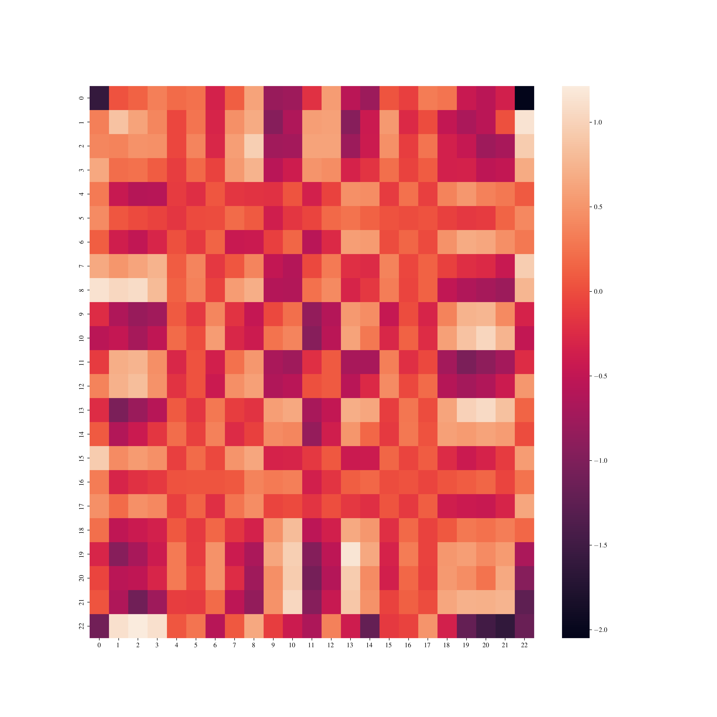
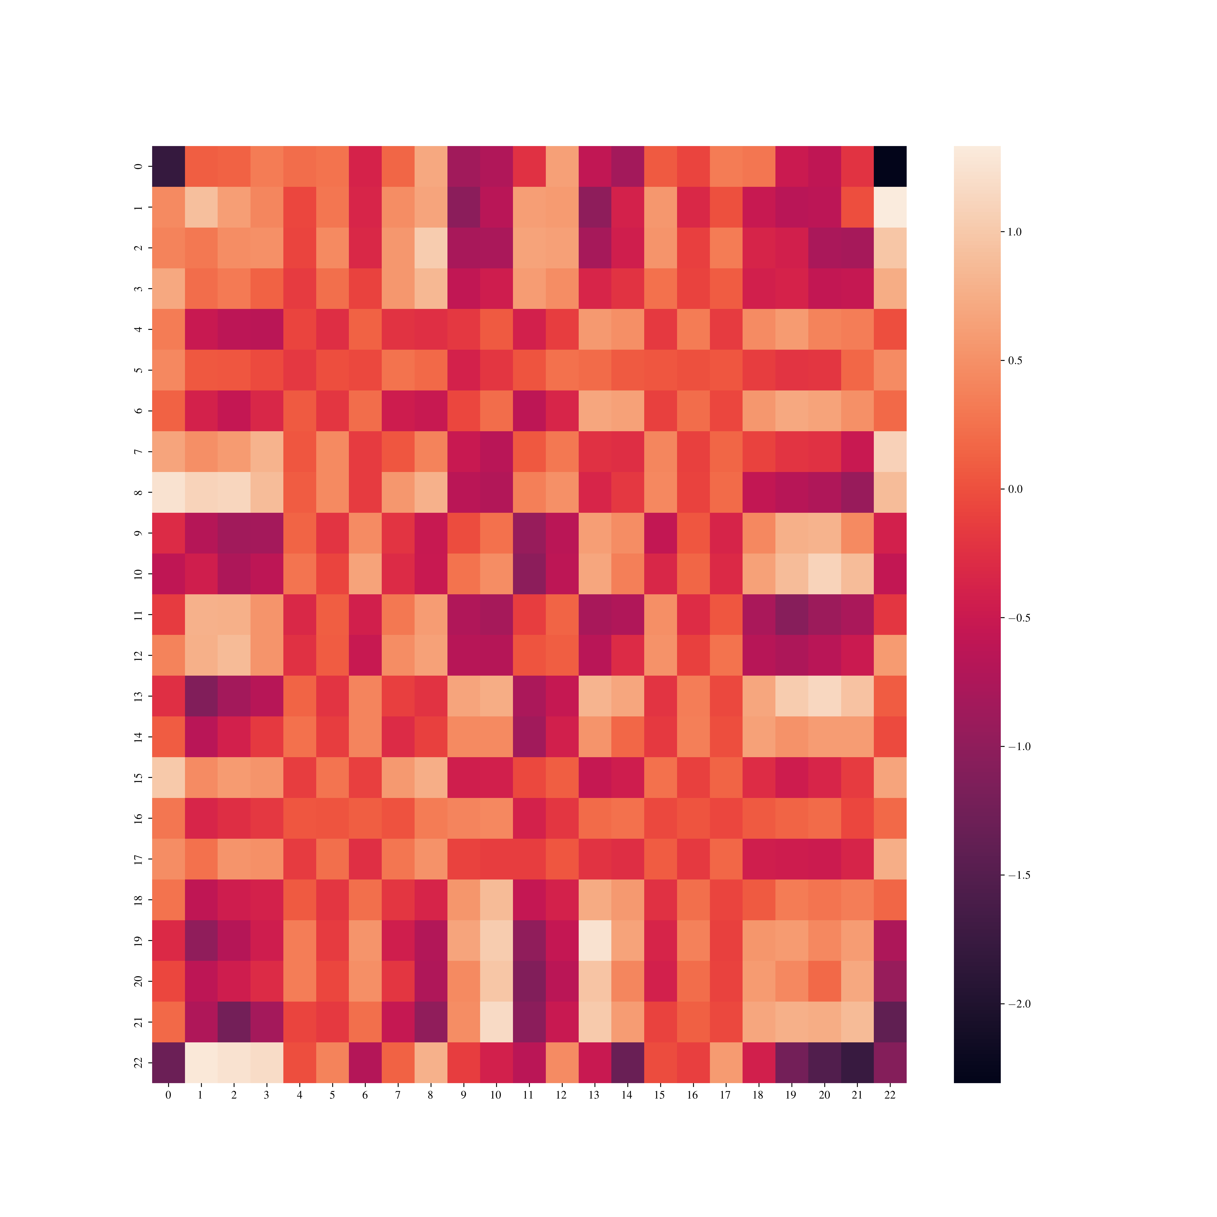

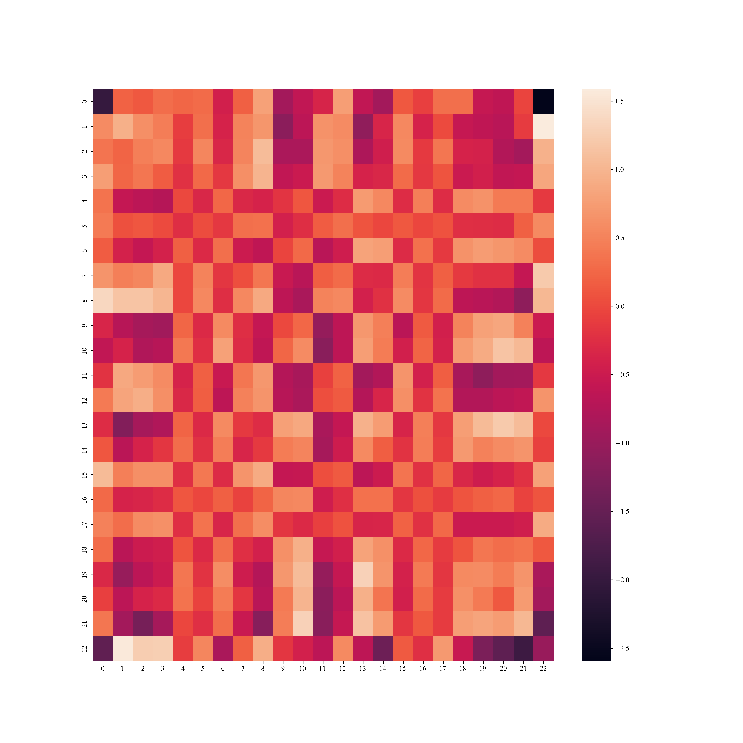
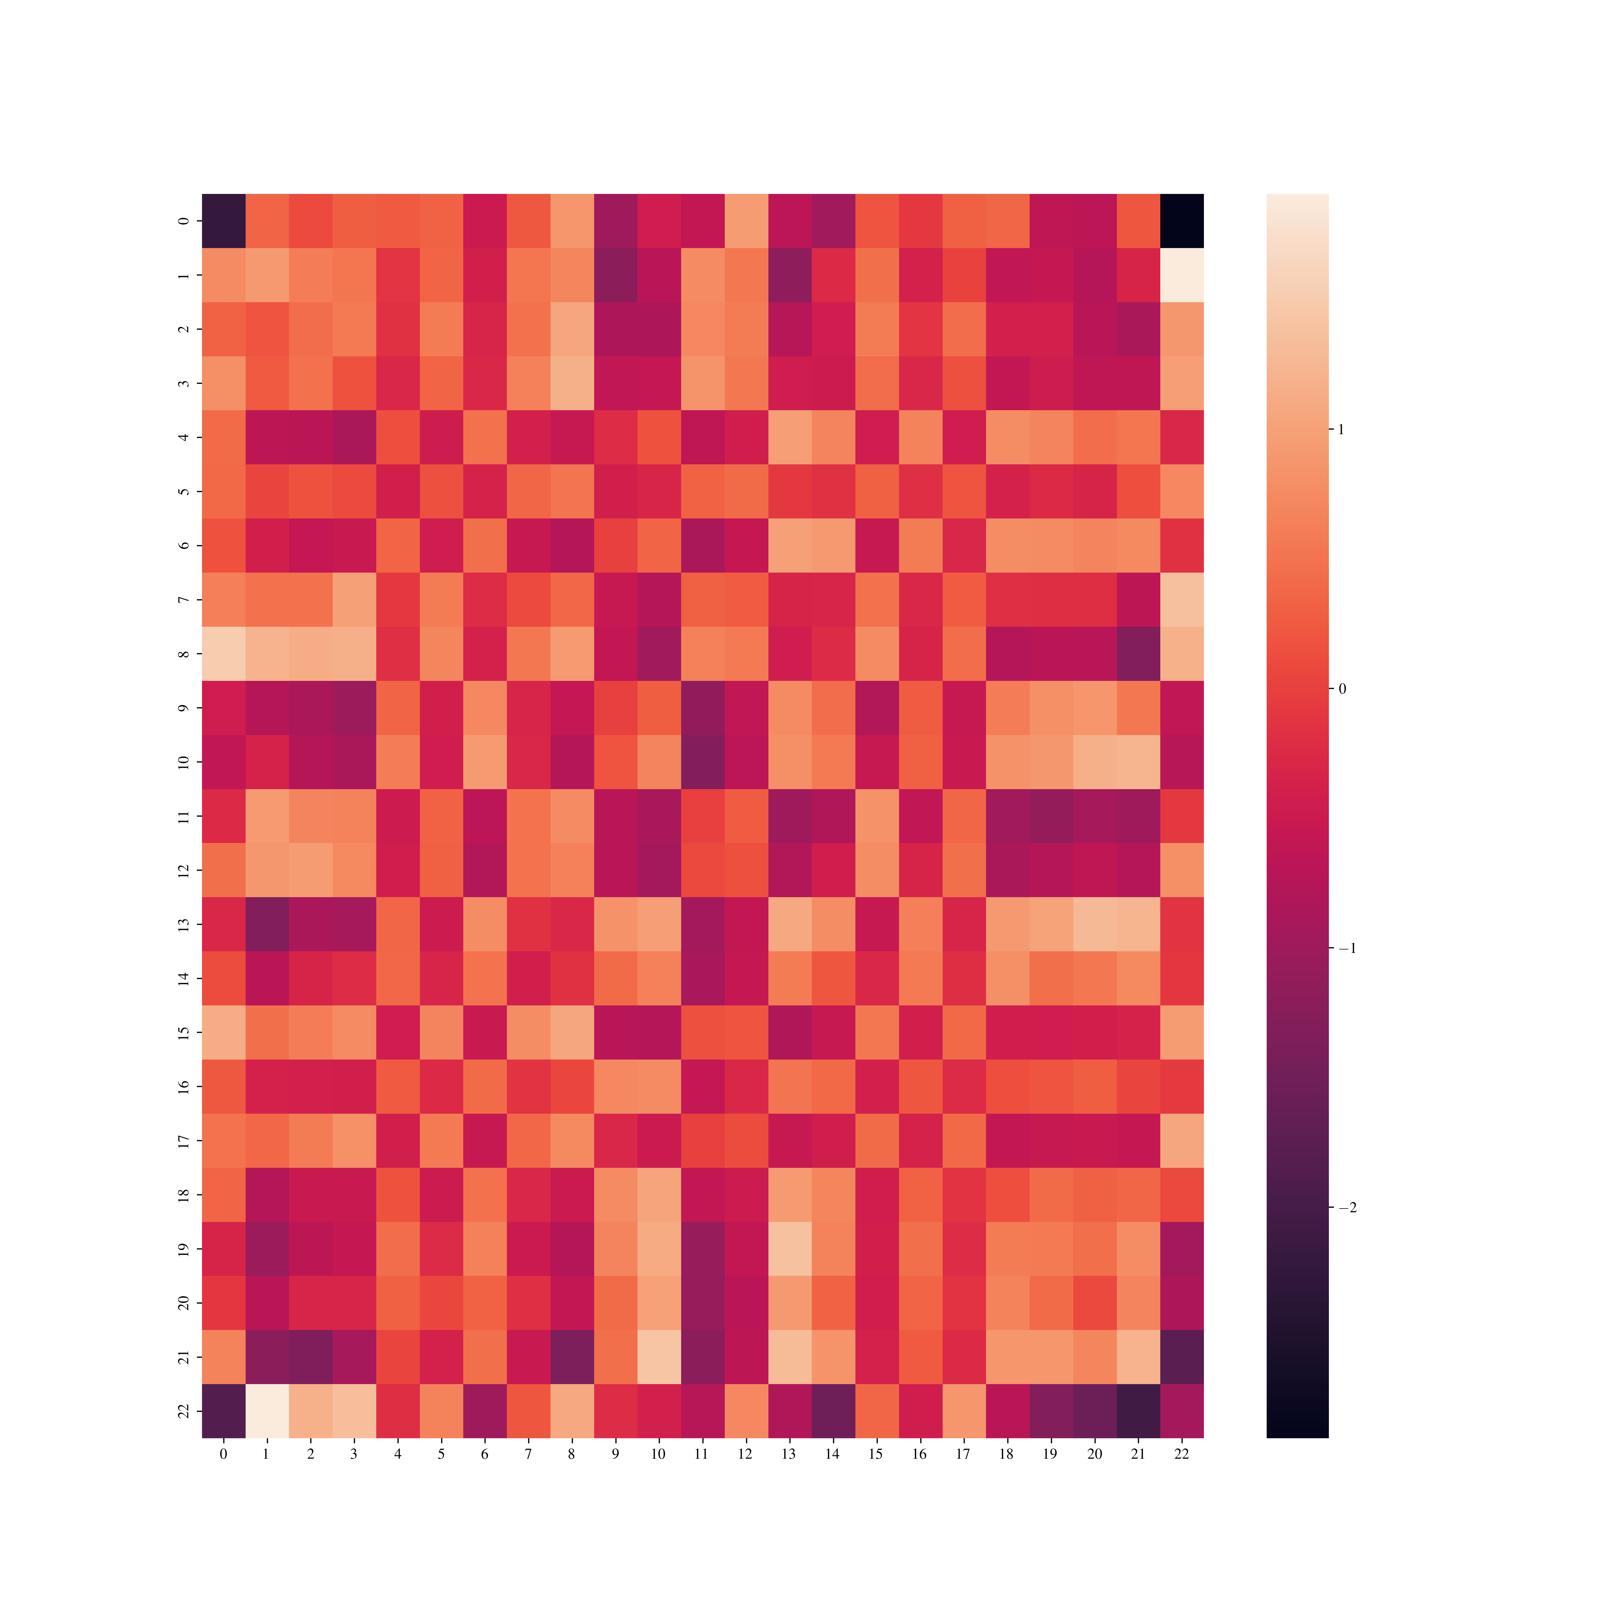
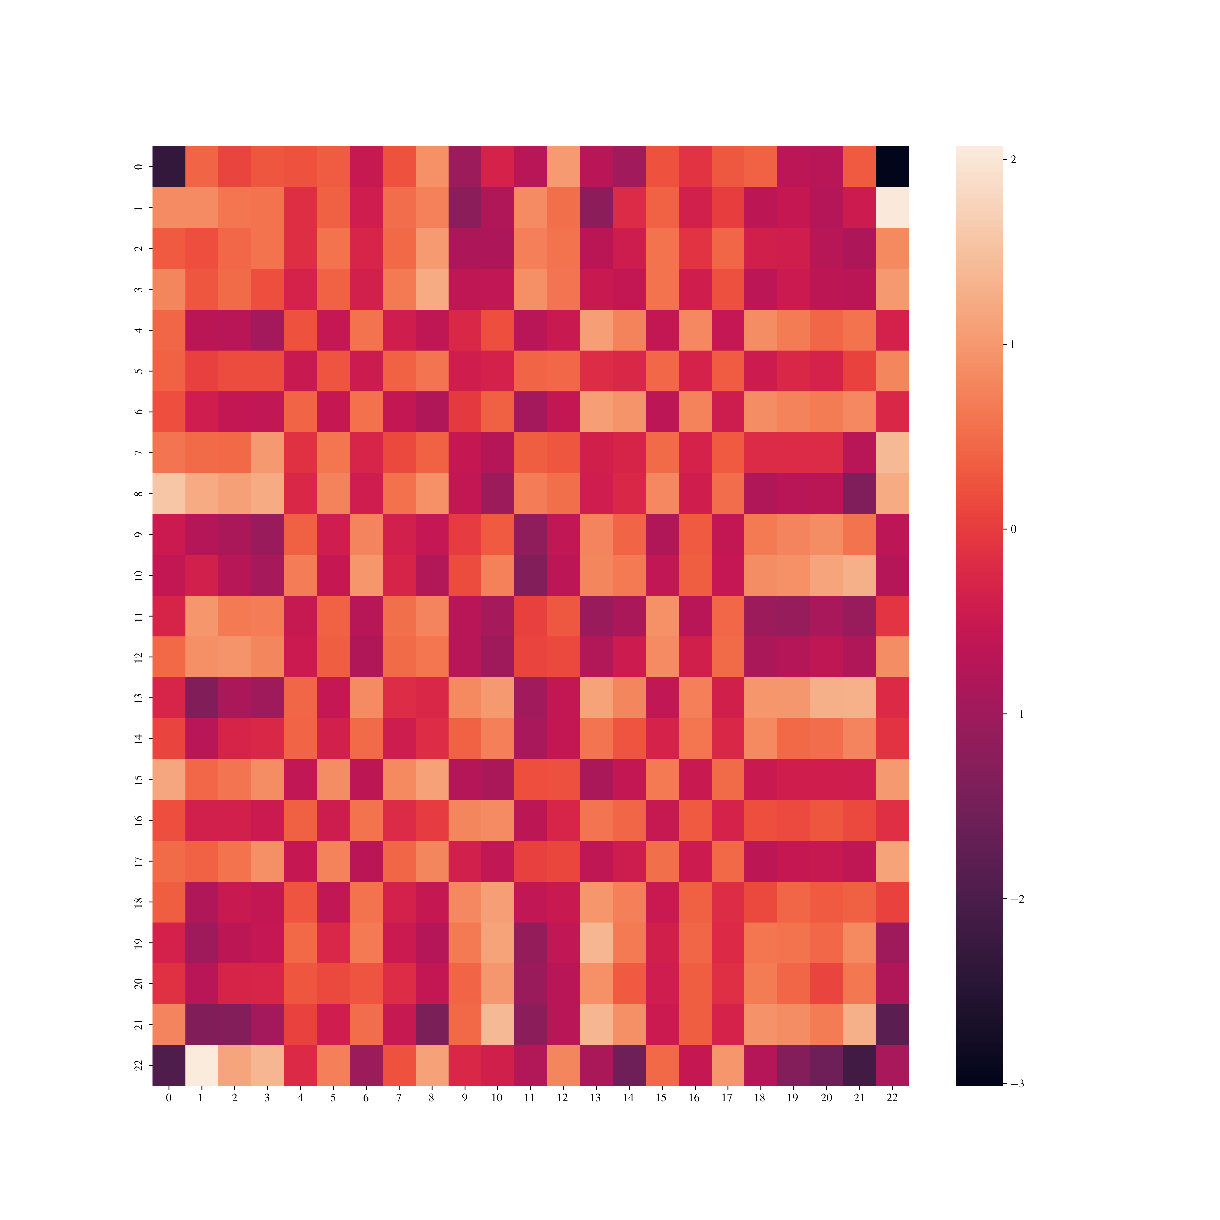

10 epochs
20 epochs
30 epochs
40 epochs
60 epochs
100 epochs
150 epochs
200 epochs

Slide 15
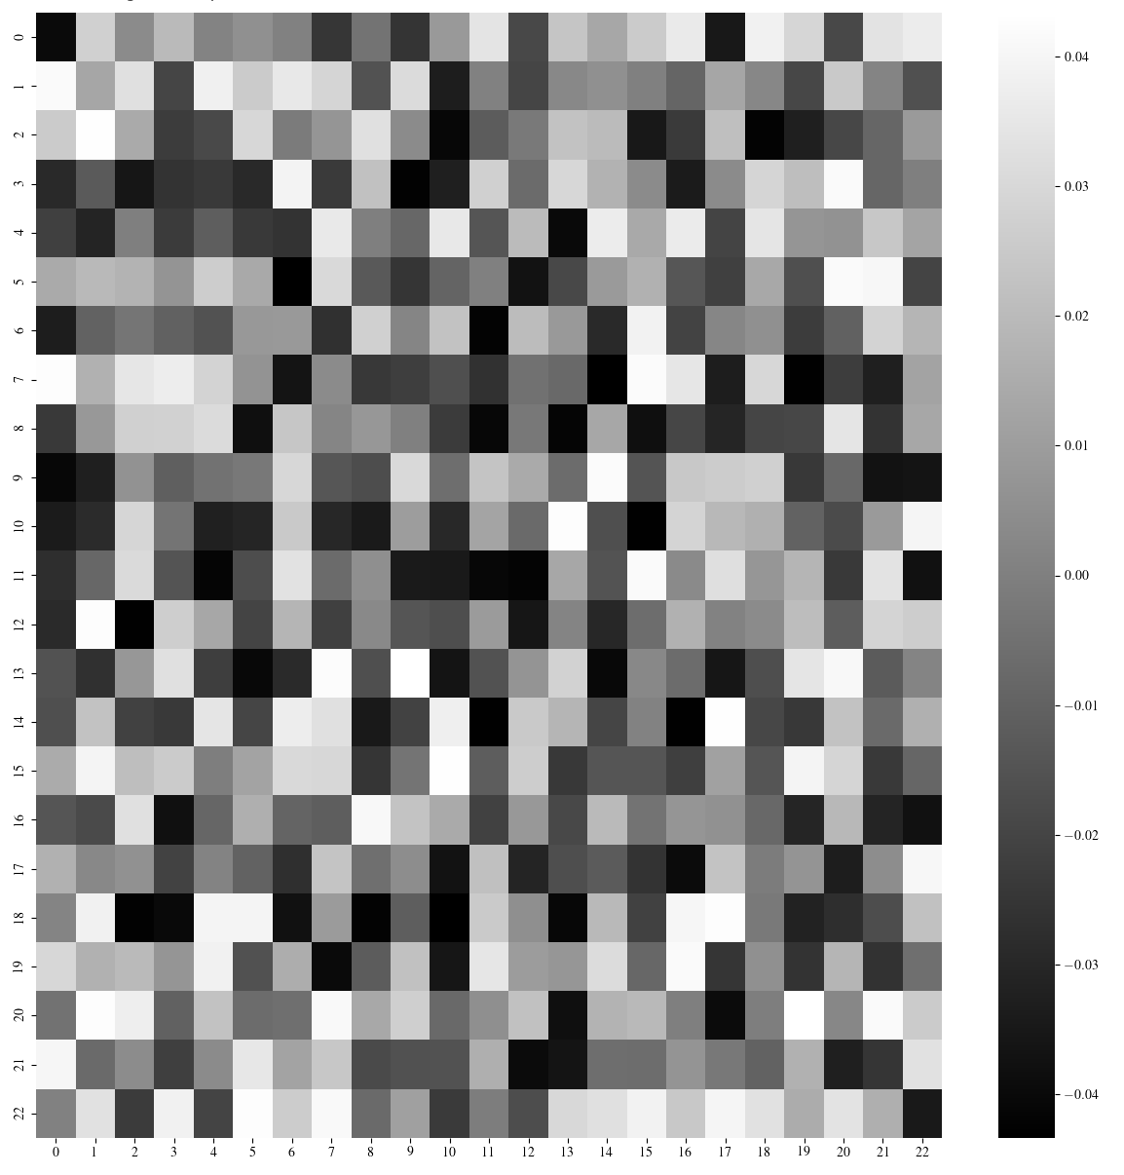
Model’s initial weights

